Slide 1

Machine Learning for Social Data Analysis
Dr. Ashish Kumar Tripathi Department of Computer Science & Engineering Malviya National Institute of Technology, Jaipur

Slide 2
Introduction
Some popular problems of social media analysis :
Sentiment analysis.
Fake news detection.
Rumor detection.
Depression analysis.
Credibility detection.
Hate speech detection.
Disruptive Event Detection

Slide 3
What is Clustering?
Organizing data into classes such that there is
high intra-class similarity
low inter-class similarity
Finding the class labels and the number of classes directly from
the data (in contrast to classification).
More informally, finding natural groupings among objects.

Slide 4





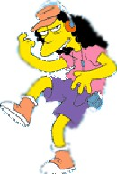



What is a natural grouping among these objects?

Slide 5




What is a natural grouping among these objects?
Clustering is subjective
Simpson's Family School Employees
Females
Males

Slide 6
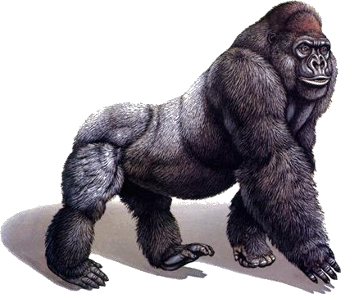
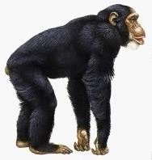
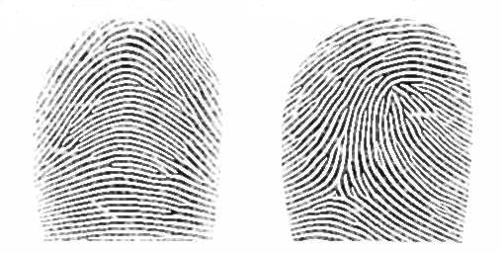











Defining Distance Measures
Definition: Let O1 and O2 be two objects from the universe of possible objects. The distance (dissimilarity) between O1 and O2 is a real number denoted by D(O1,O2)
Kasun
Kiosn
0.23
3
342.7

Slide 7
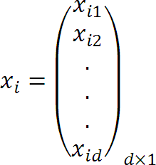


Consider a Set of Data Points,
And a Set of Clusters,

Slide 8


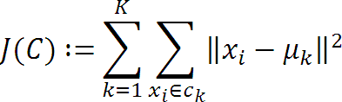
The Goal,

Slide 9
Algorithm k-means
Randomly choose K data items from X as initial centroids.
Repeat
Assign each data point to the cluster which has the closest centroid.
Calculate new cluster centroids.
Until the convergence criteria is met.

Slide 10
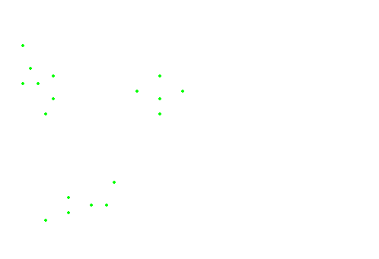
The data points

Slide 11
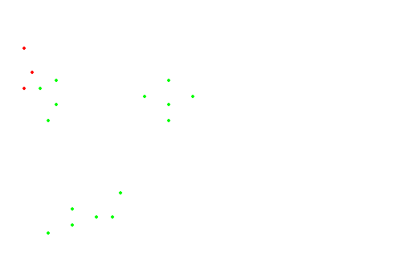
Initialization

Slide 12
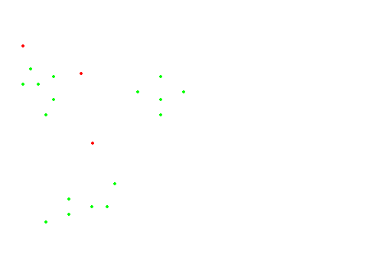
#Runs = 1

Slide 13
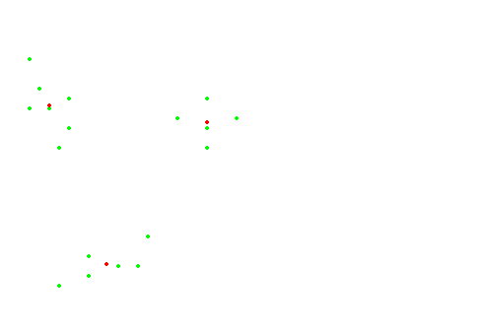
#Runs = 2

Slide 14
#Runs = 3

Slide 15
K-means gets stuck in a local optima

Slide 16
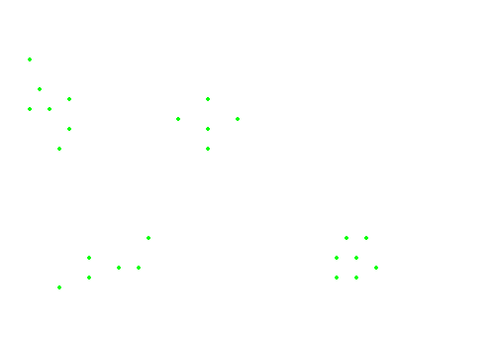
The data points

Slide 17
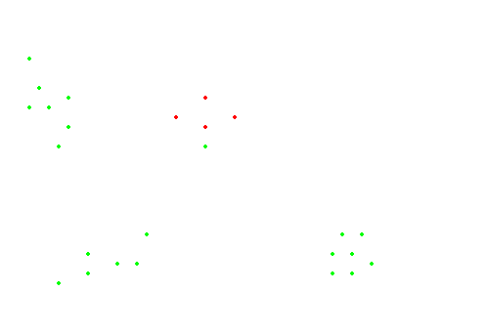
Initialization

Slide 18
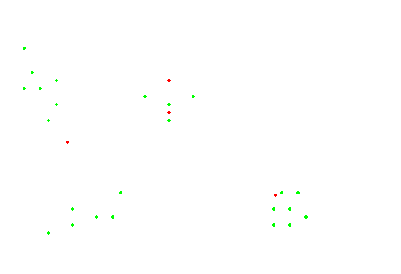
#Runs = 1

Slide 19
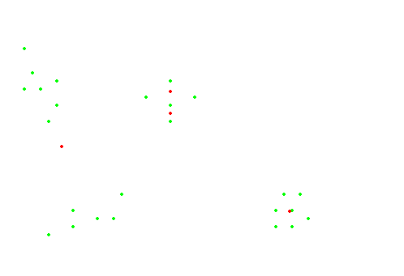
#Runs = 2

Slide 20
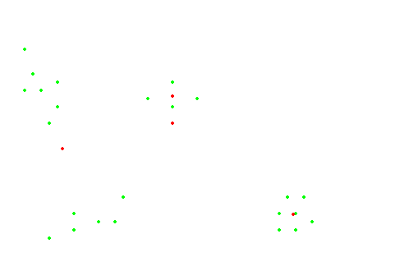
#Runs = 3

Slide 21
#Runs = 4

Slide 22
Comments on the K-Means Method
Strength
Relatively efficient: O(tkn), where n is # objects, k is # clusters,
and t is # iterations. Normally, k, t << n.
Weakness
Applicable only when mean is defined, then what about categorical
data?
Often terminates at a local optimum. The global optimum may be found using techniques such as: deterministic annealing and genetic algorithms.
Need to specify k, the number of clusters, in advance
Unable to handle noisy data and outliers
Not suitable to discover clusters with non-convex shapes

Slide 23
Efficient data mining using nature-inspired computing
Nature-inspired computing:
Algorithms inspired from nature
Provide optimal solution
Less time is required to solve complex optimization
Stochastic algorithms:
Global search(exploration)
Local search(exploitation)
Some popular nature inspired algorithms:
Genetic algorithms (GA)
Particle swarm optimization (PSO)
Cuckoo search(CS), etc.
Nature-inspired algorithms not only provide optimal solution but also solve complex optimization problems in reasonably less time as compared to classical methods.

Slide 24


Clustering using Meta-heuristic methods
Initialize all the parameters such as no. of clusters, no of populations, etc.
Step1: Generate N initial populations (x1,x2……,xn) randomly. Step2: Calculate fitness of each individual using the equation:
where k=1,2,...K is the number of clusters, xi , i=1,2,...nk are the patterns in the kth cluster, ck is centre of the kth cluster. Here the cluster centres are represented by:
Step 3: Assign each data points to k randomly selected cluster centroids, using Euclidean distance.
Step 4: Find the current best. Step 5:
while t < MaxGeneration
Step 5.1: do Generate N new individuals using meta-heuristic methods (PSO, DE, ..) Step 5.2: Calculate the fitness of new individuals using equation 1.
Step 5.3: Assign new individuals to k randomly selected cluster centroids, using
Euclidean distance. end while
Step 6: Print the best solution and its fitness.

Slide 25
Steps to run job
Open mozila and write 50070 on address bar.
upload file to HDFS using command hadoop fs -copyFromLocal input.txt /
run jar using command
hadoop jar wordcount.jar /input.txt /out/

Slide 26
FAKE REVIEW DETECTION PUBLIC DATASETS
Data sets
Dataset Name | Number of Instances | Source | Description
Ott dataset | 1600(800 fake, 800 real) | Trip Advisor, Yelp, Hotels.com | Prepared by Mylee Ott.,100 USD was paid to each user for writing fake reviews
Yelp review | 1280000( 60,000 fake, 68,000 real) | Yelp.com | Extracted from Yelp using beautiful soup library.
@
4/24/2023
4
4

Slide 27
FAKE REVIEW DETECTION
Important Features
Name Of Feature | Description | Name Of Feature | Description
Word count | Total number of words in the review | Branding Frequency | Number of times brand name used
Verb Count | Number of verbs | Adjective Count | Number of adjectives used in the review
Spam Hit Score | Number of words similar to the Spam review | Truth Hit Score | Number of words similar to the truth review
Diversity | Count of unique words | Adverb | Number of adverbs used
Noun | Number of nouns in the review | Preposition | Number of prepositions used \sentiment score
sentiment score | variation between sentiment polarity and rating of reviews | Average content similarity | It is defines as the average similarity in the reviews given by a single reviewer
@
4/24/2023
45

Slide 28




















FAKE REVIEW DETECTIION
Complete Flow of the Proposed Method
Collec tion of Hotel Reviews
Preprocessing
Feature Extraction
Start
Determine Highest Fitness Value
Evaluate the Fitness
Initialize
population Using the data
Update Islands
Cluster Data Using Optimal Centroids
Criteria Satisfied
@
4/24/2023

Slide 29


FAKE REVIEW DETECTION FOR LARGE SCALE DATA SETS USING PARALLEL BBO
The Results of the Proposed Method
Dataset Name | Criteria | K-means | K-PSO | Black Hole | DFBPKB A | MR- EGWO | BBO
Ott dataset | Best | 50.72 | 58.46 | 54.68 | 59.5 | 70.92 | 71.52
 | MCT | 580.5 | 805.6 | 816.4 | 884.6 | 876.5 | 776.5
Yelp review | Best | 50.72 | 58.46 | 54.68 | 59.5 | 71.92 | 73.52
 | MCT | 3240.5 | 4141.5 | 3980.9 | 4005.98 | 4051.2 | 3940.47
@
4/24/2023
4
7

Slide 30




Thank you !
Department of CSE/IT
⁴⁸ Jaypee Institute of Information Technology, Noida
48

